Slide 1
Advances of Federated Learning
Vimalkumar Kumaresan Ph.D

Slide 2
vimalkumar.kumaresan@gmail.com

Slide 3
Taxonomy of federated learning
Our taxonomy is motivated by the pipeline and challenges in federated learning.
Aggregation optimization,
Heterogeneous federated learning,
Secure federated learning and
Fair federated learning.

Slide 4
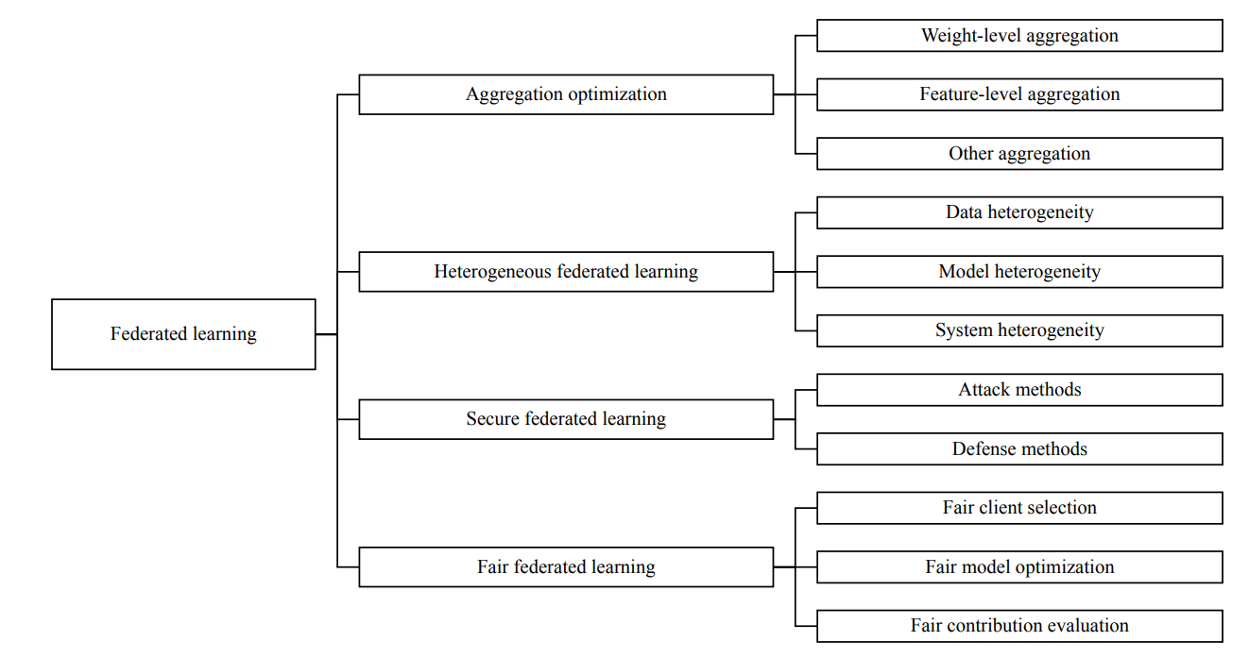

Slide 5
Future Direction
Dynamic federated learning - catastrophic forgetting problem
Decentralized federated learning
Scalability of federated learning
Unified benchmark

